Slide 1
Intro to Neural Networks
By- Shreyash Soni

Slide 2
Some pointers.
Join the WhatsApp group.
Get Anaconda up and running.
Go through the Python tutorial.
Get comfortable with the IPython Notebook interface.
Follow the GitHub repository.

Slide 3

Classification Example
Acceptance in a University
Information
Results of a test
Grades in School

Slide 4
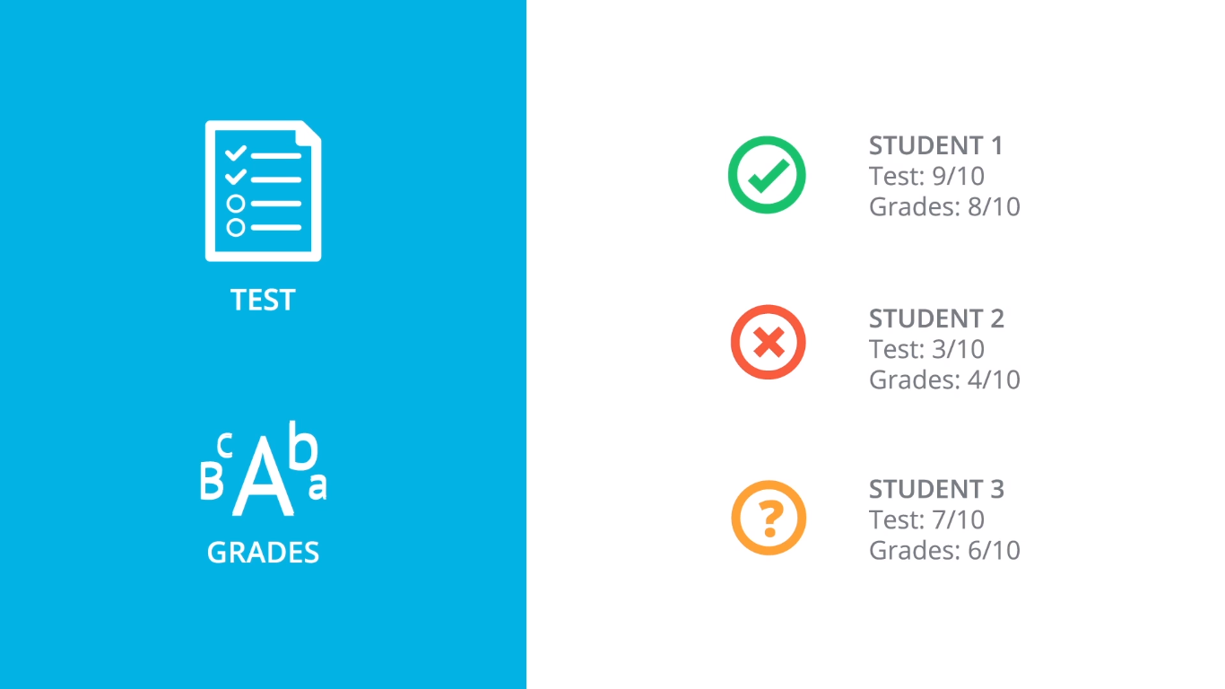

Slide 5
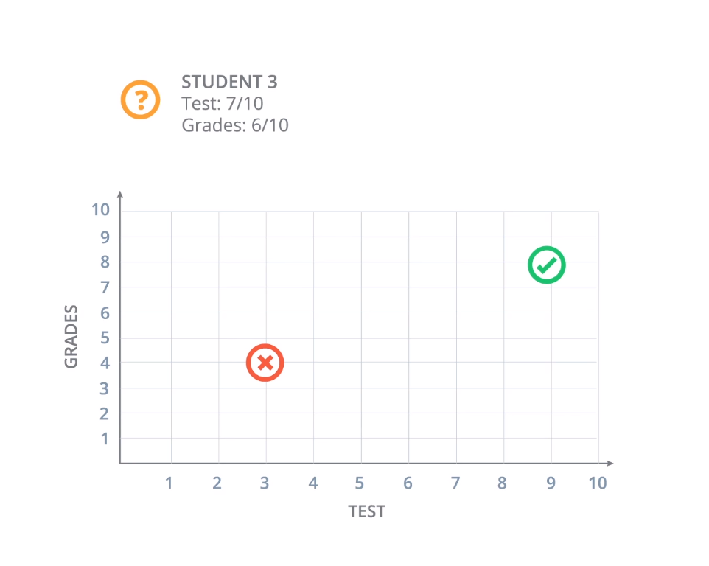

Slide 6
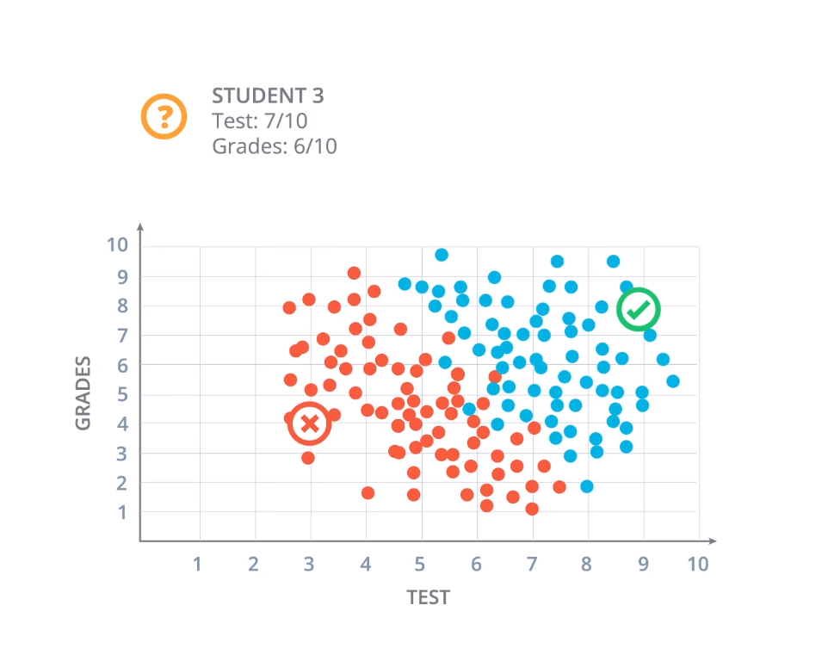

Slide 7
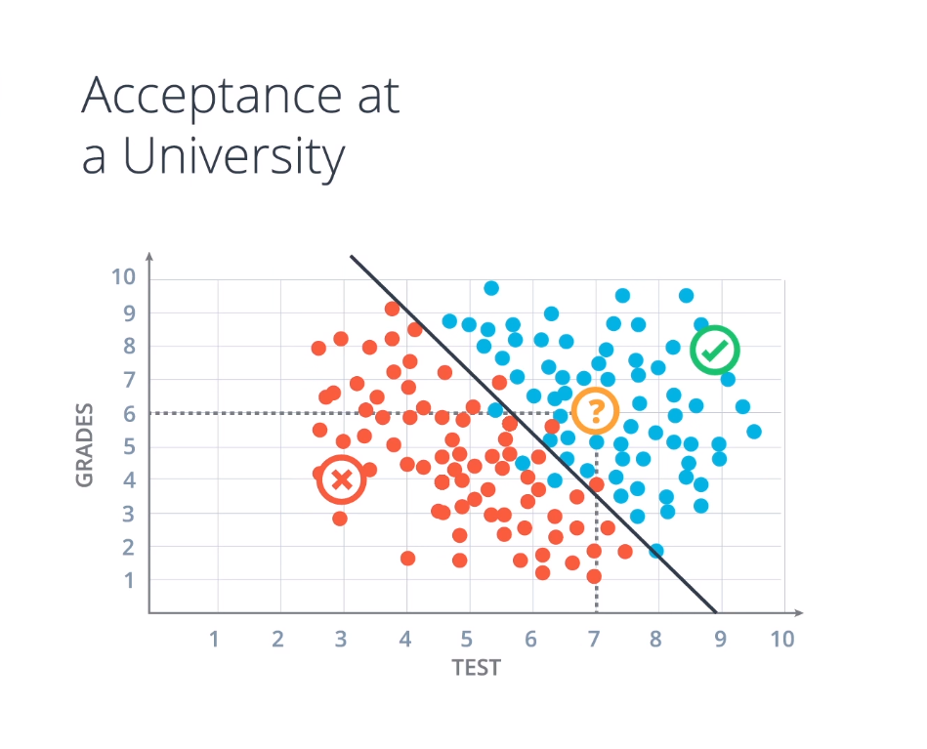
How do we find this line?

Slide 8
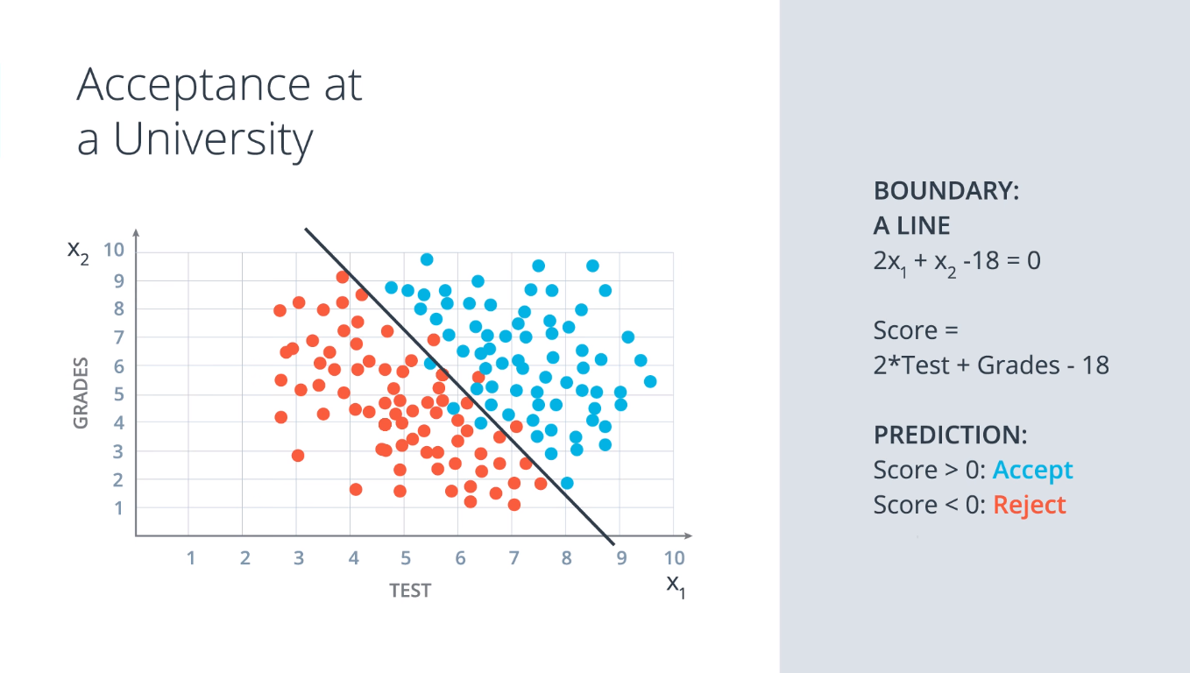

Slide 9
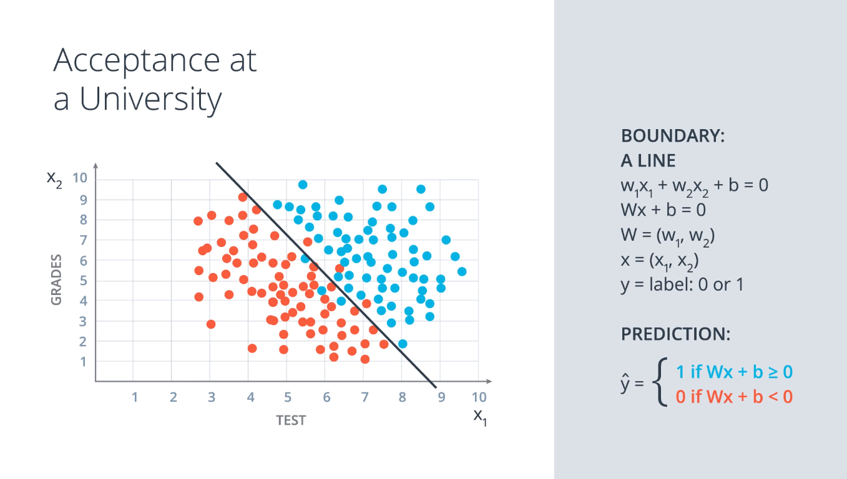

Slide 10
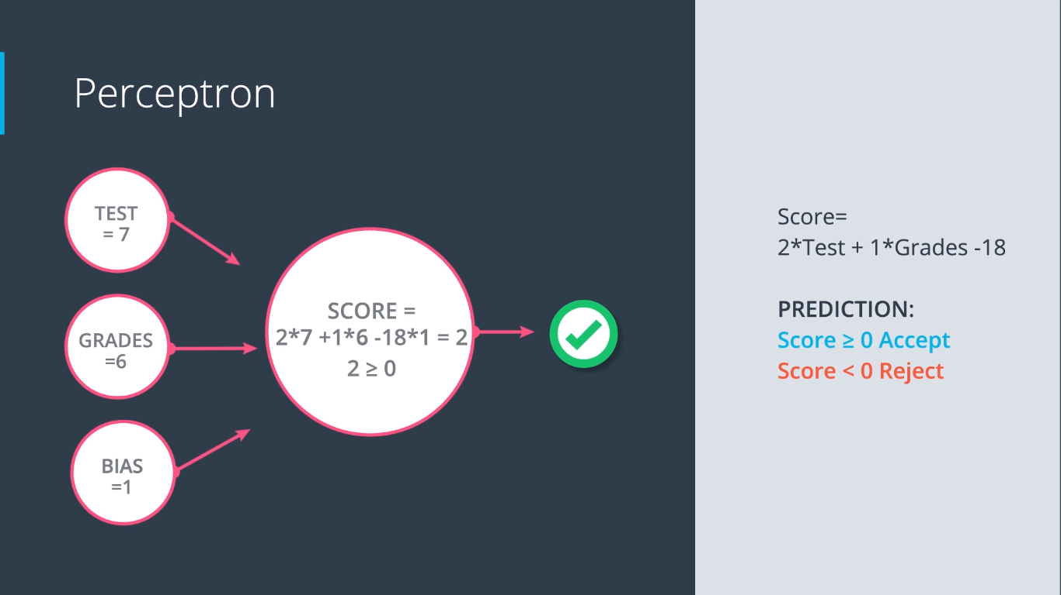

Slide 11
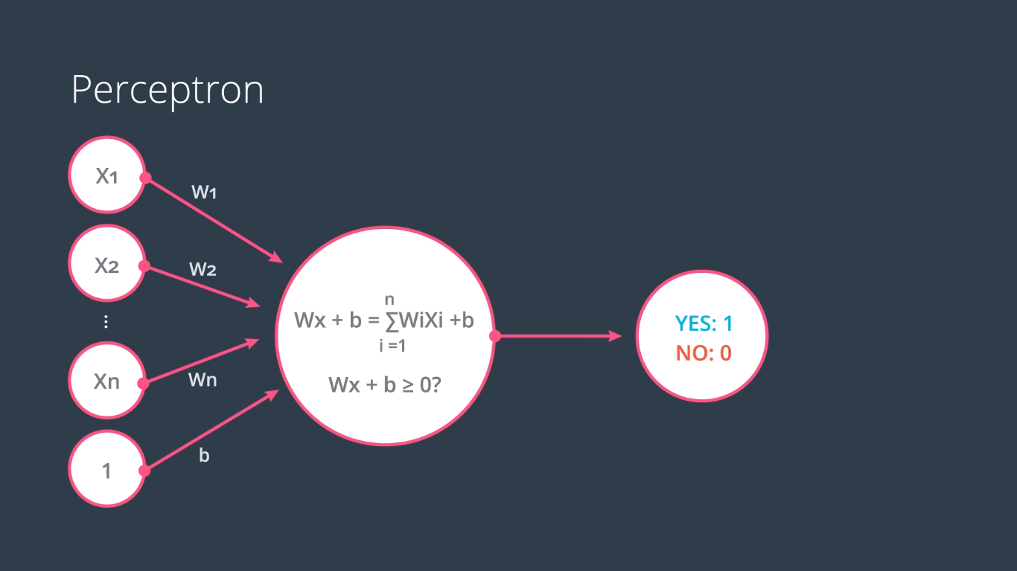

Slide 12
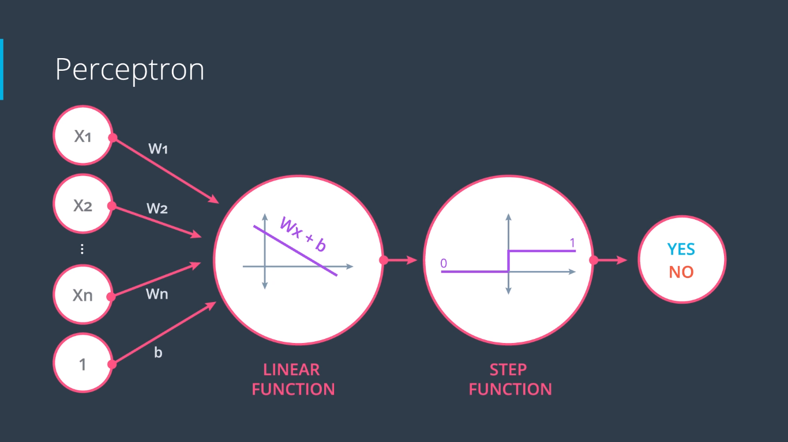

Slide 13
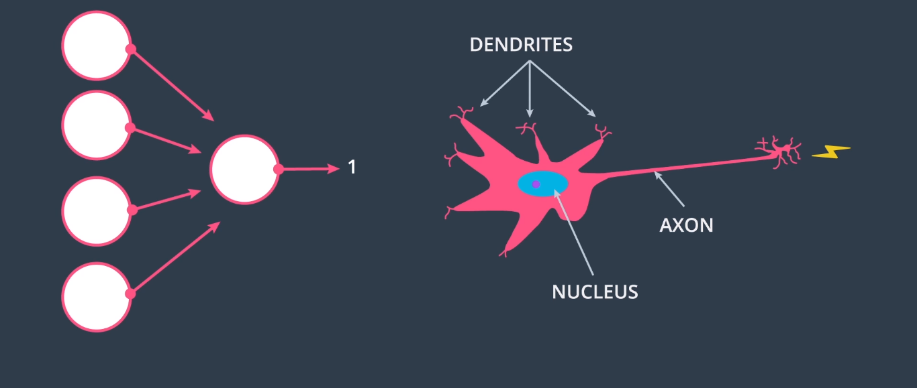
Why ‘neural networks’?

Slide 14
Neural Networks as Logical Operators
AND, OR, XOR

Slide 15
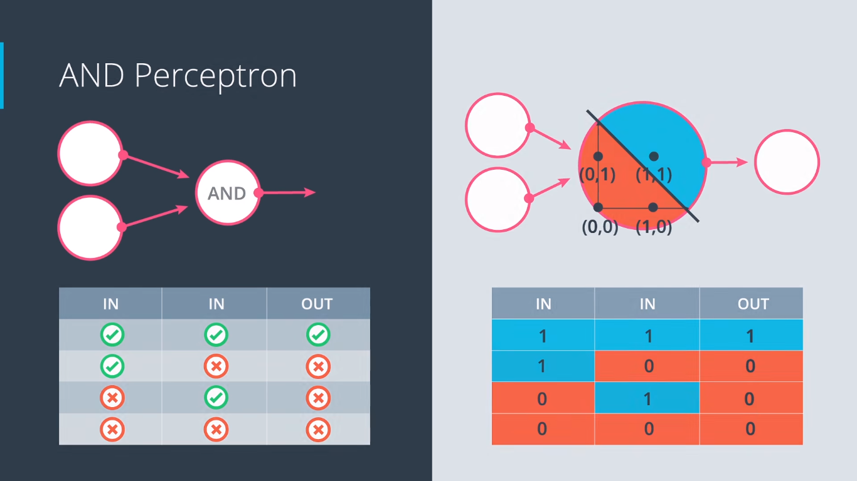

Slide 16
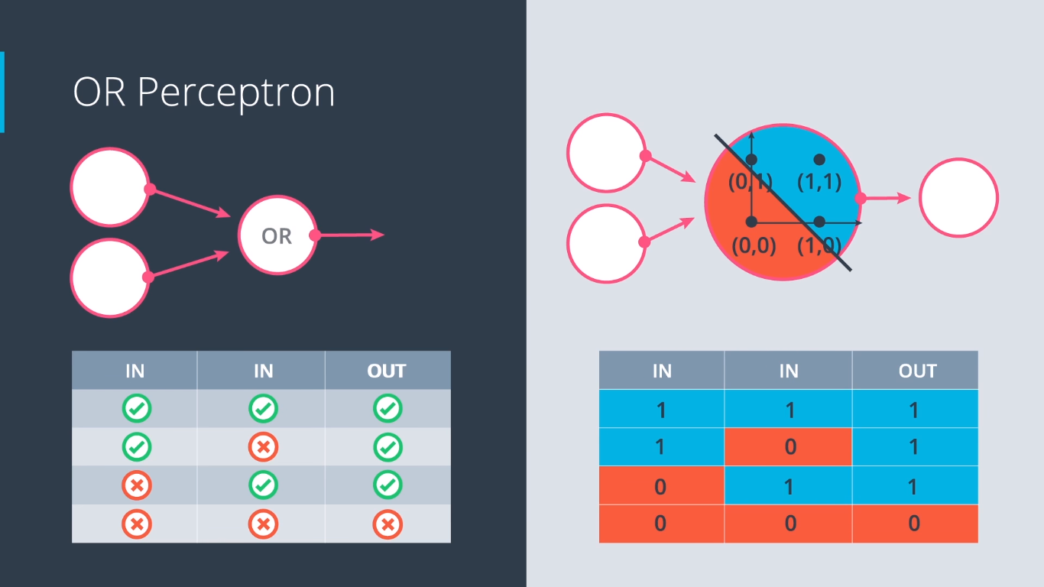

Slide 17
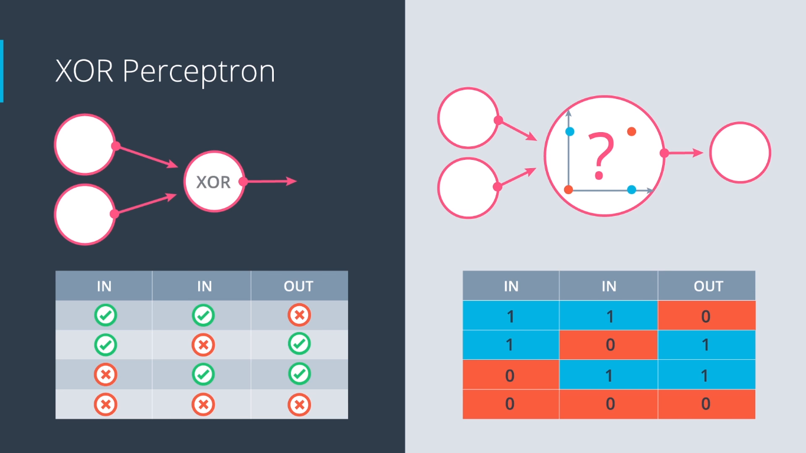

Slide 18
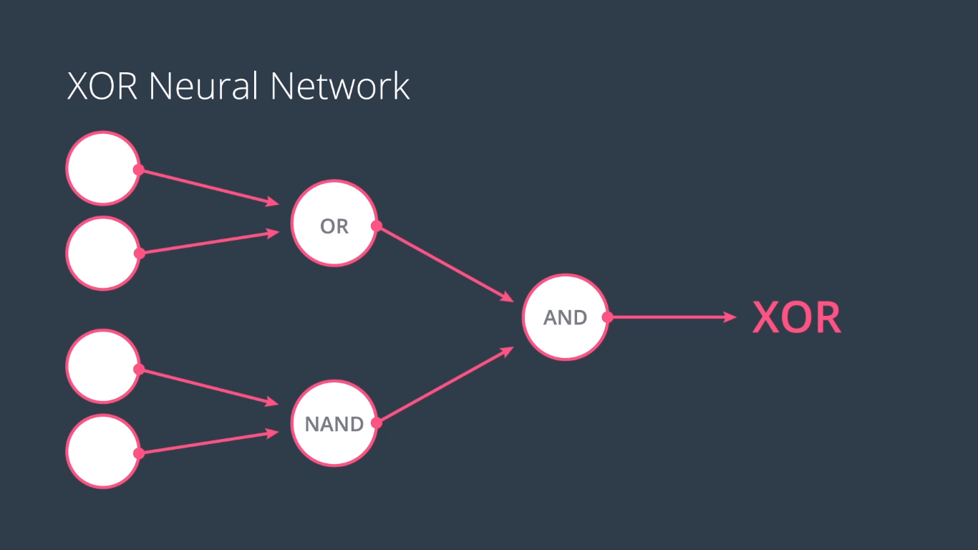

Slide 19
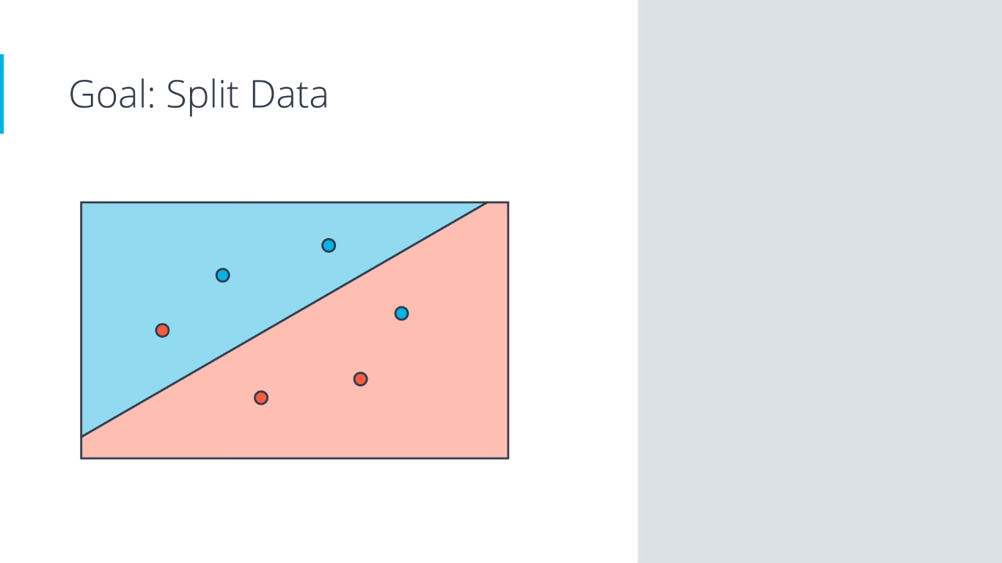

Slide 20
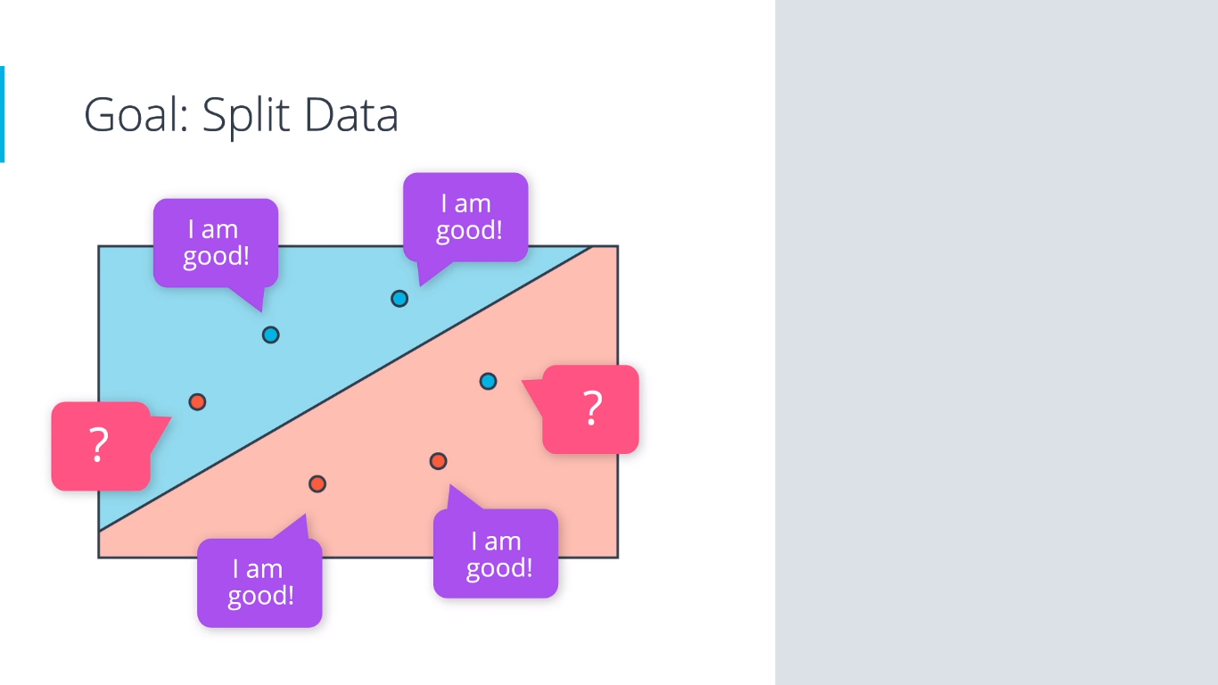

Slide 21
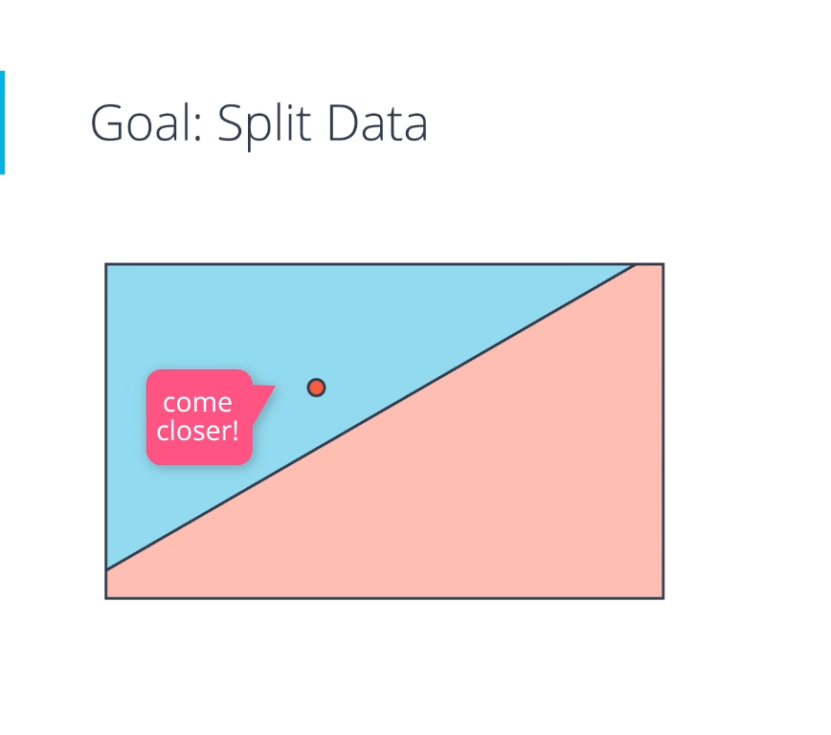
How?
Perceptron Algorithm.

Slide 22
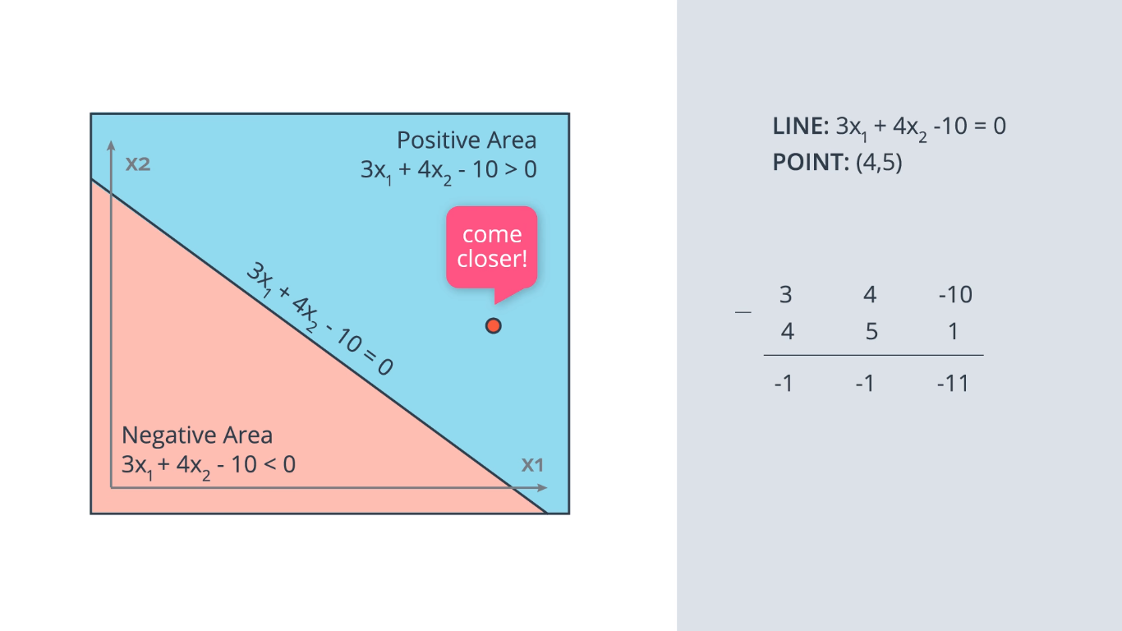

Slide 23
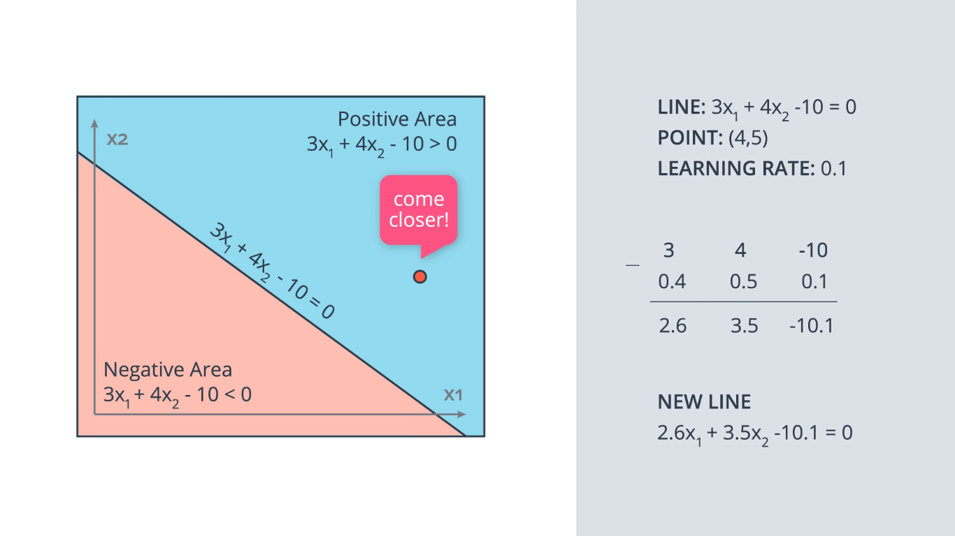

Slide 24
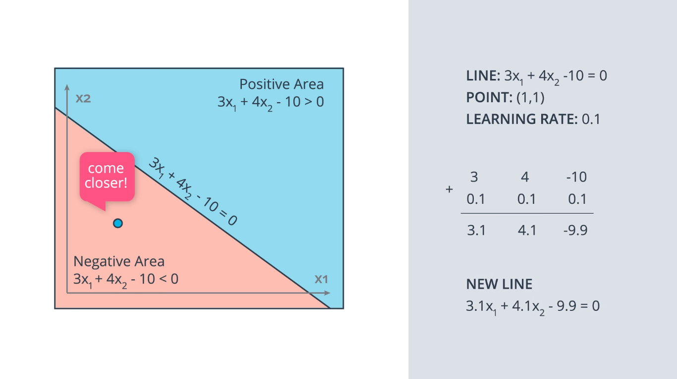

Slide 25
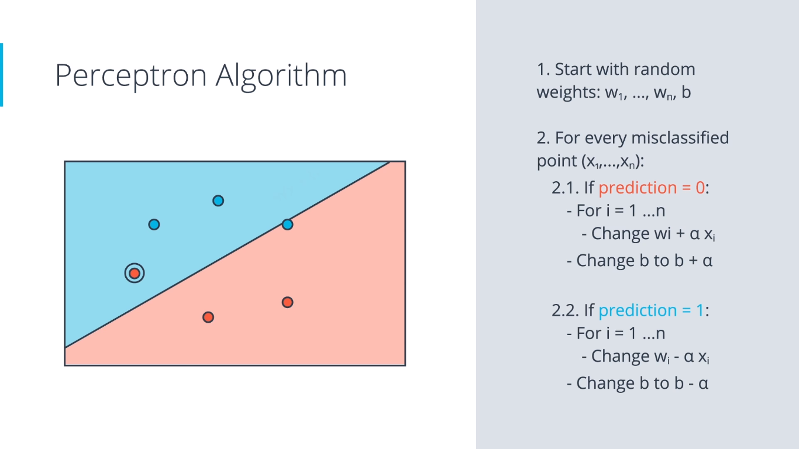

Slide 26

Higher Dimensions

Slide 27
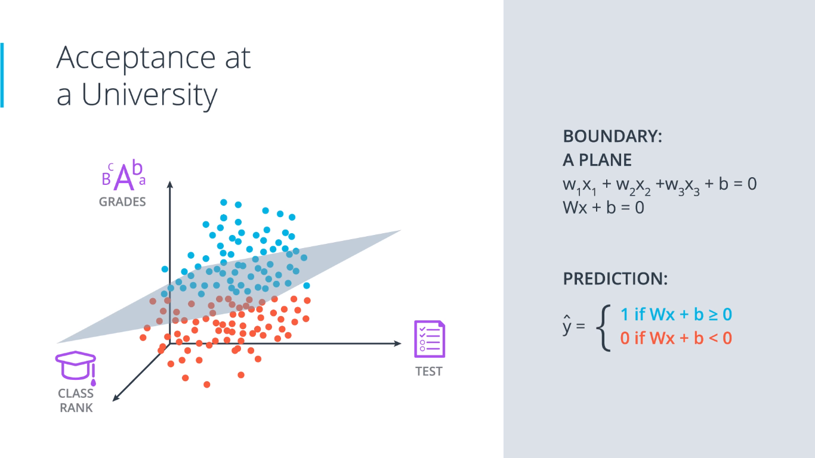

Slide 28
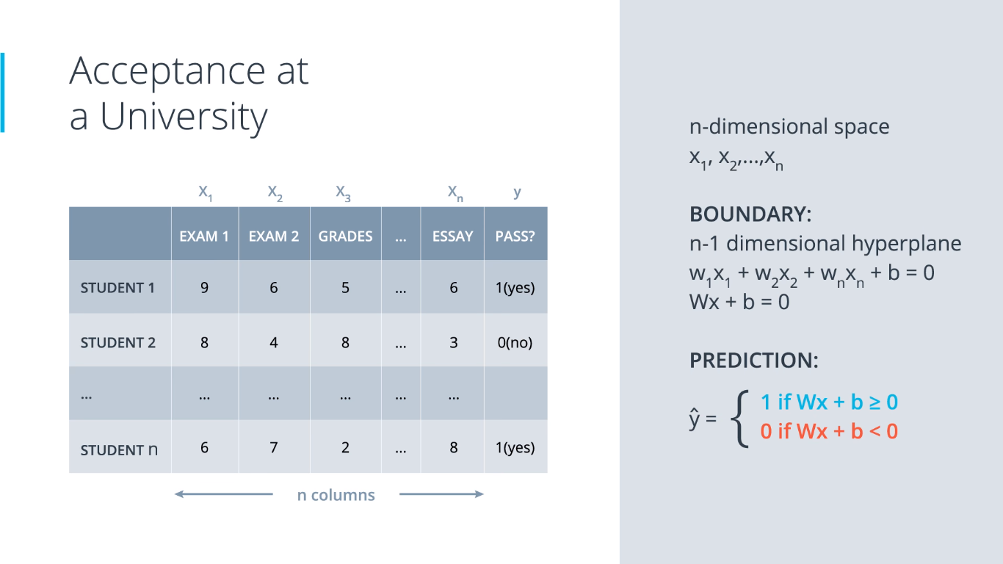

Slide 29
Error Functions
Log-Loss, Cross-Entropy

Slide 30


Slide 31


Minimize error

Slide 32
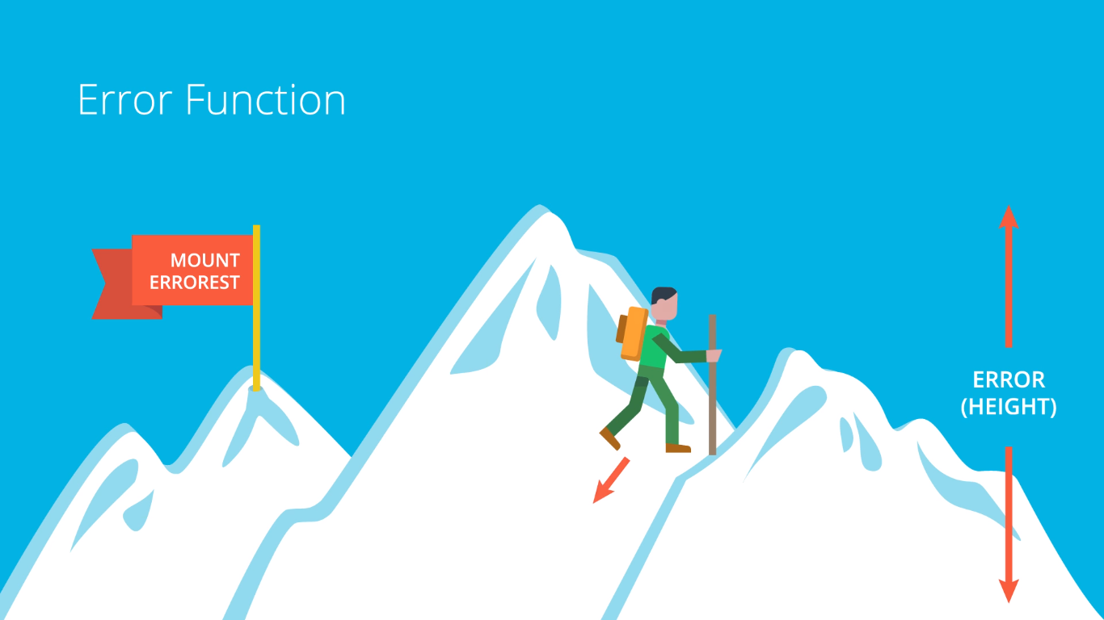

Minimize error

Slide 33
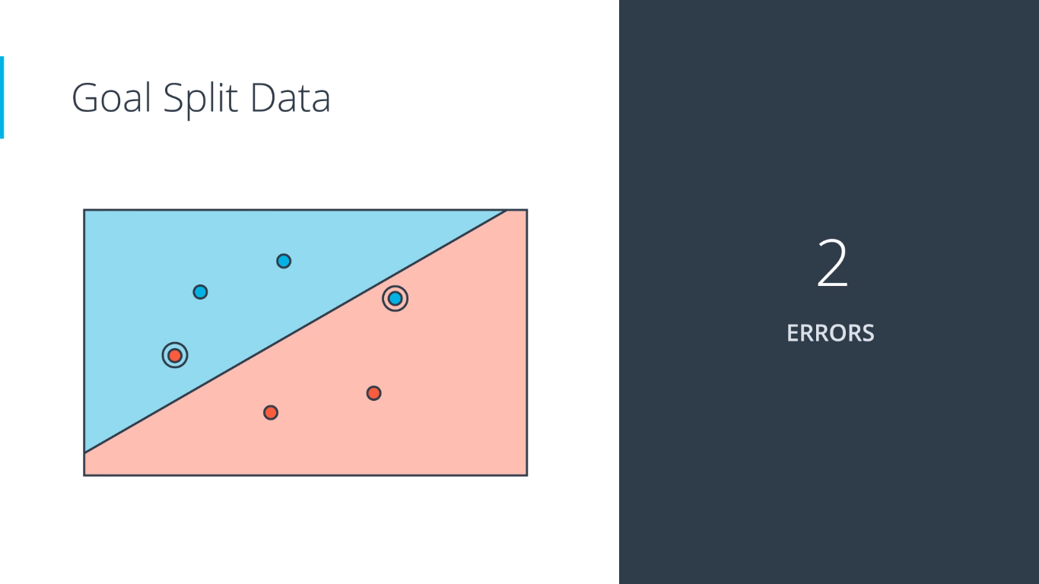
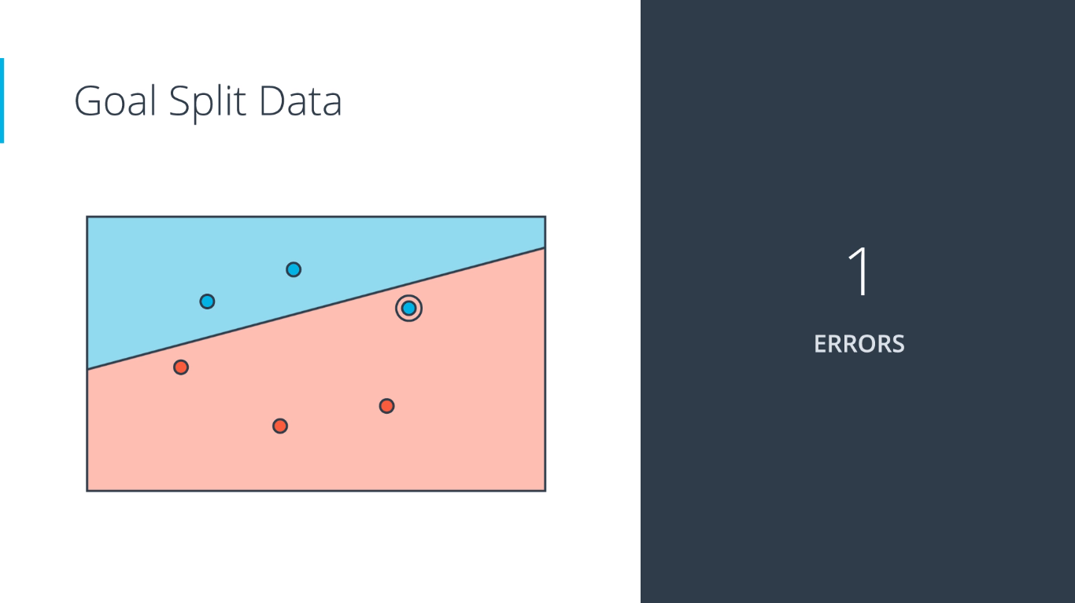
Minimize error

Slide 34
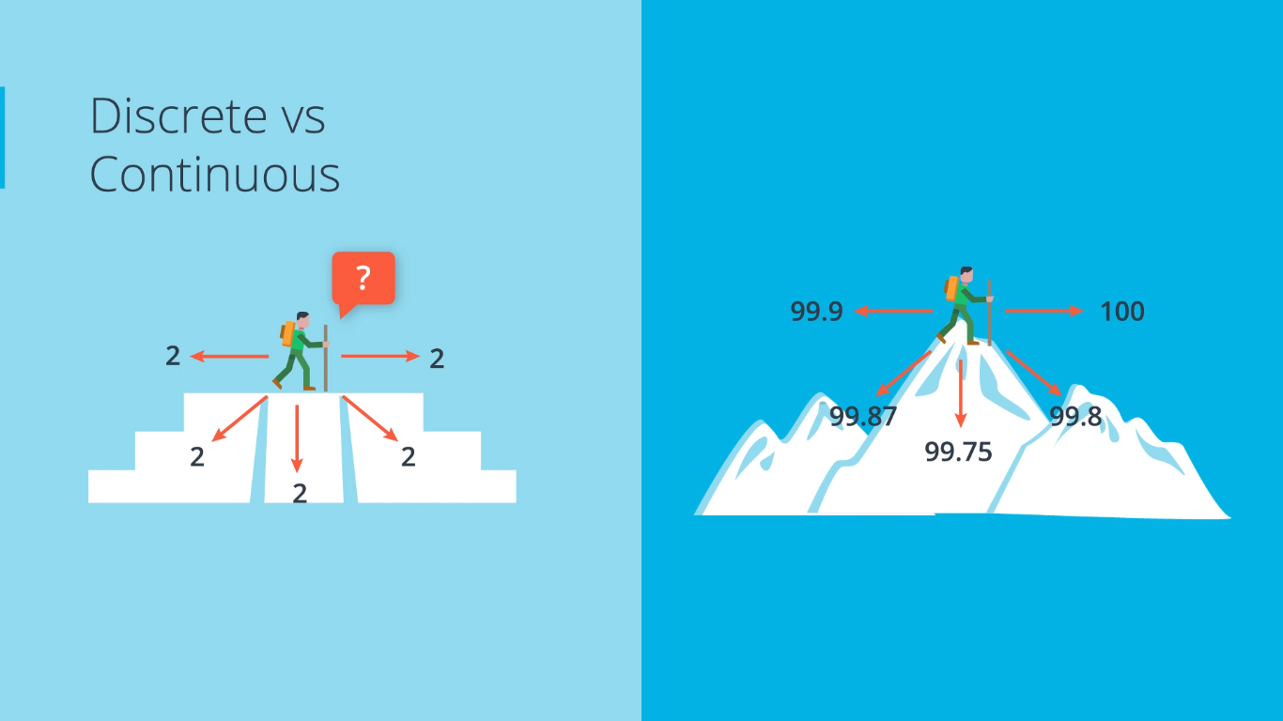

Slide 35
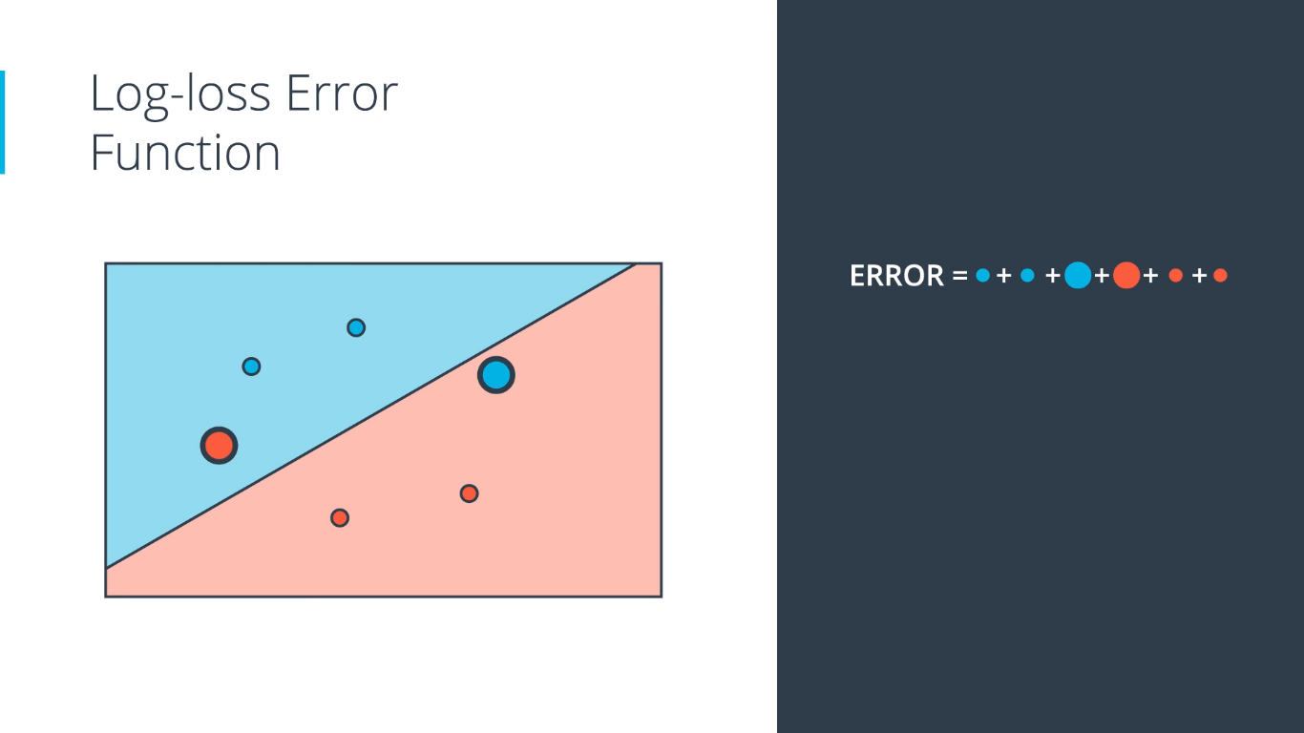
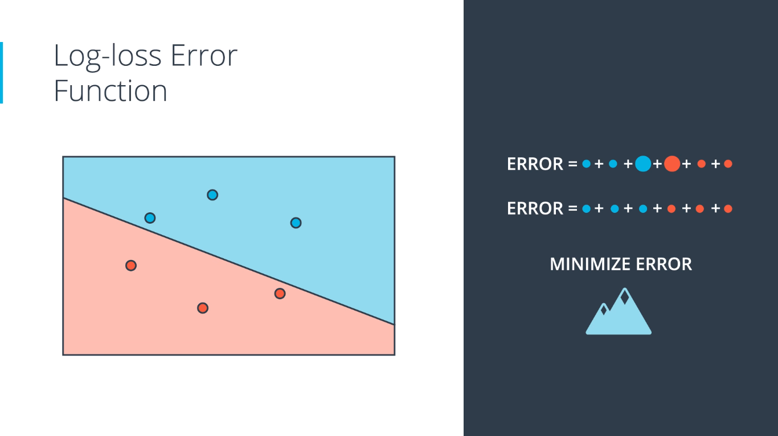
Minimize error continuously.

Slide 36
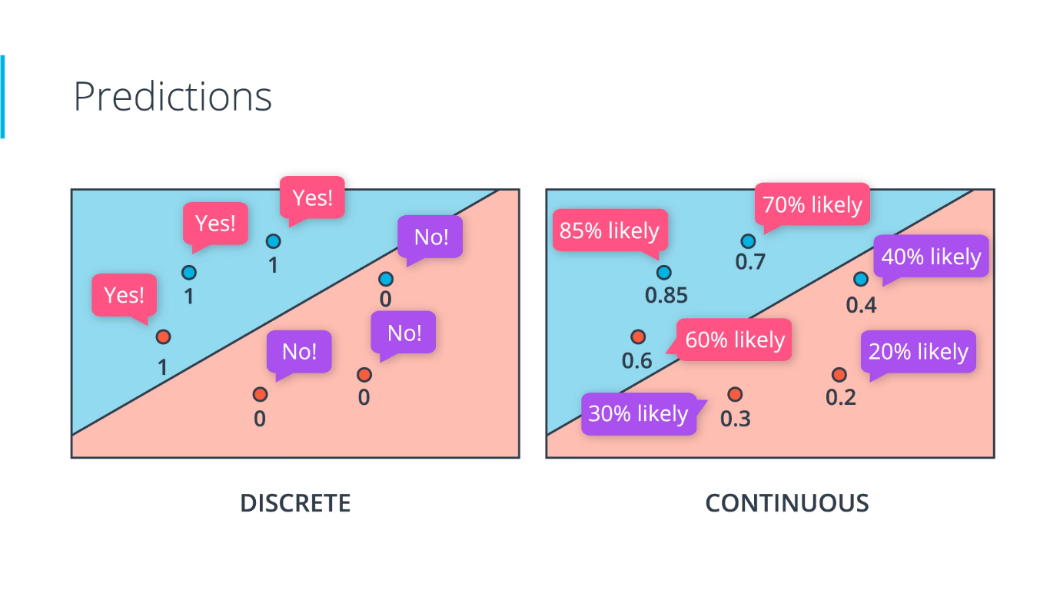

Slide 37
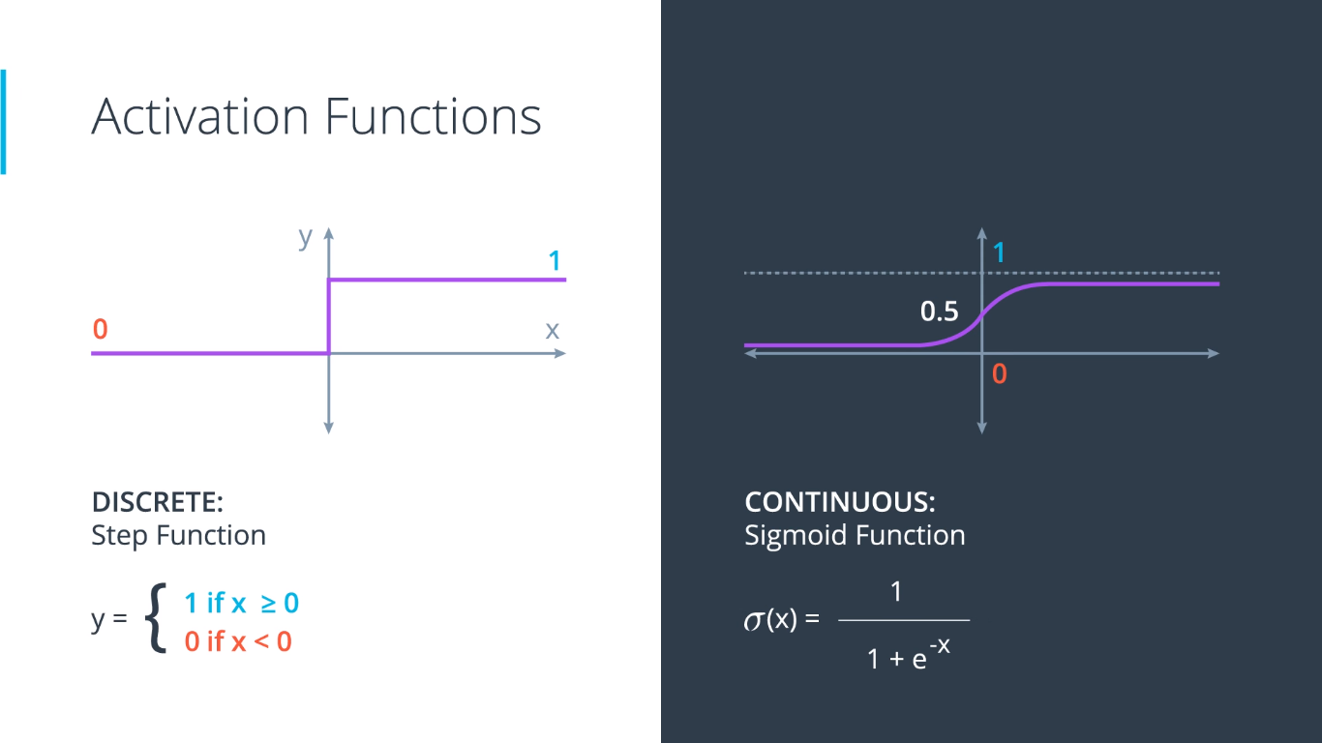

Slide 38
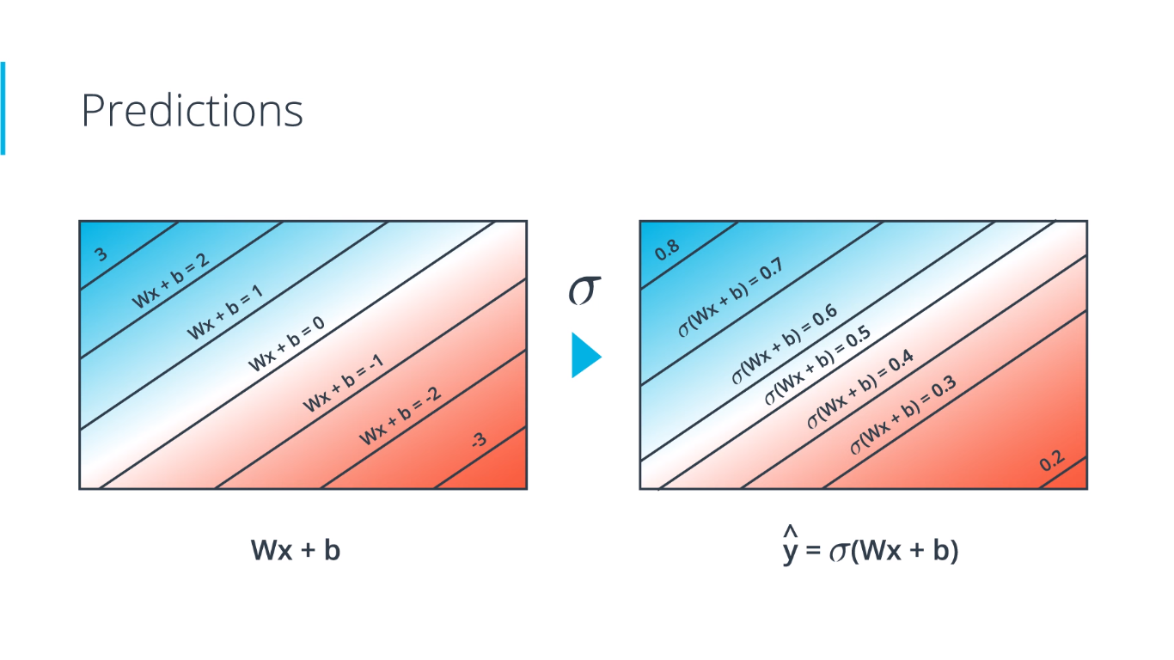

Slide 39
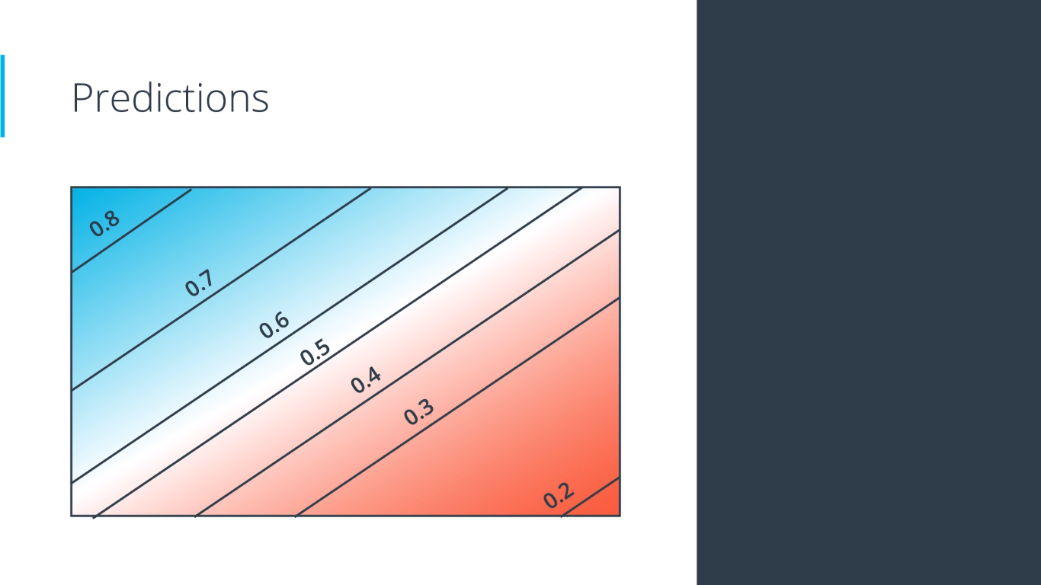

Slide 40


Discrete to Continuous.

Slide 41
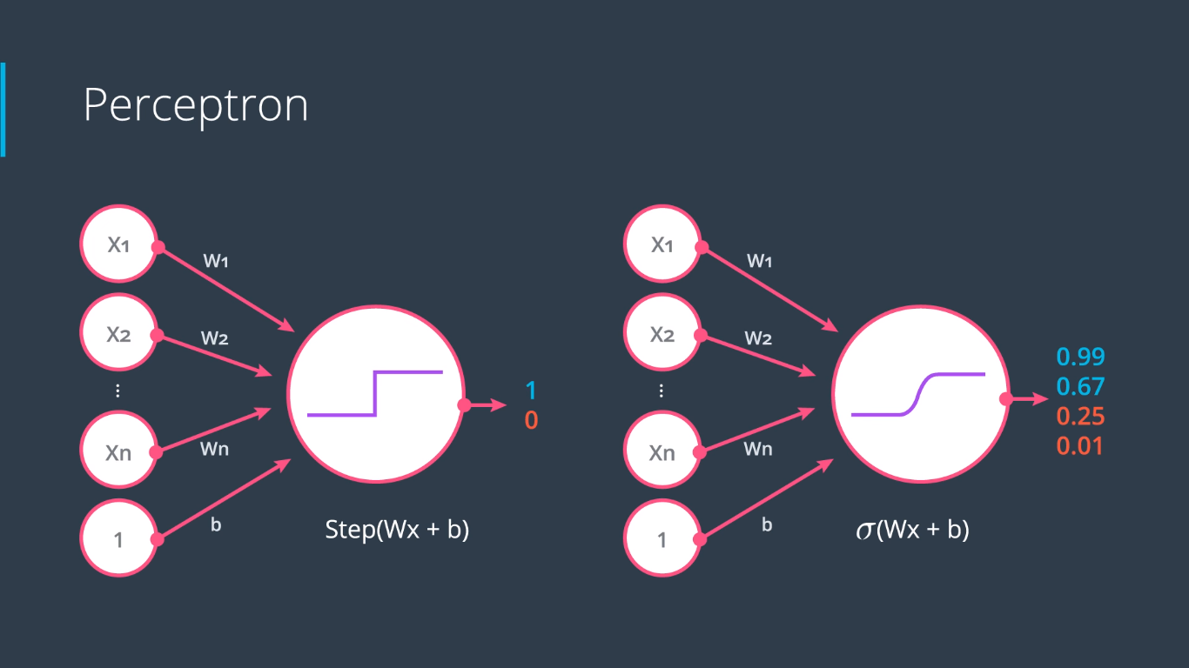

Slide 42
Multi-Class Classification
SoftMax function.

Slide 43
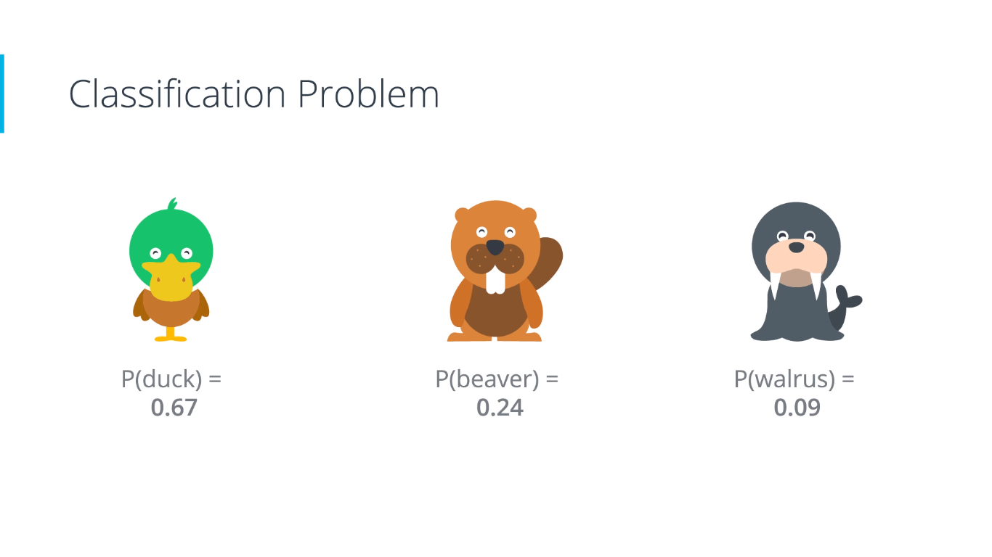

Slide 44
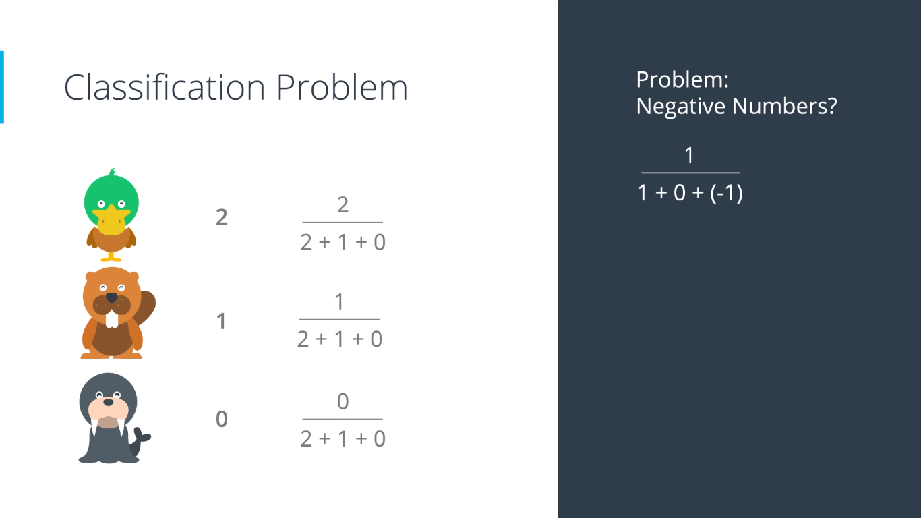

Slide 45
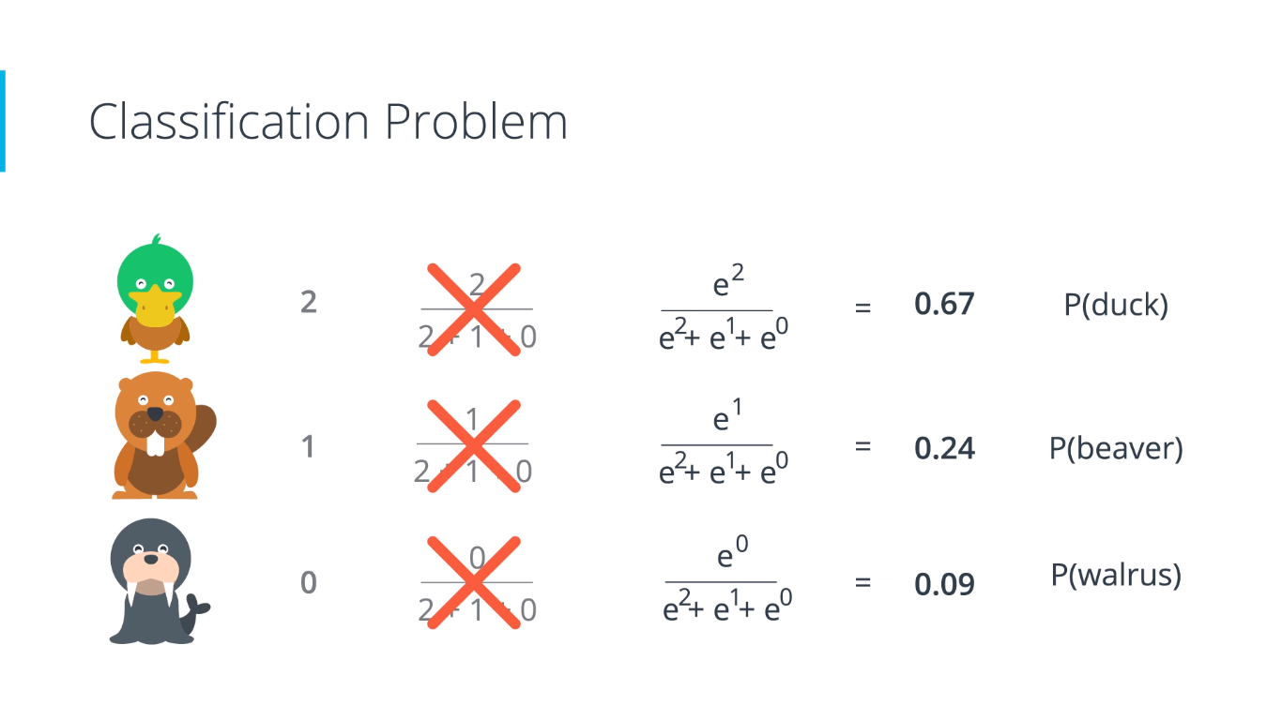

Slide 46
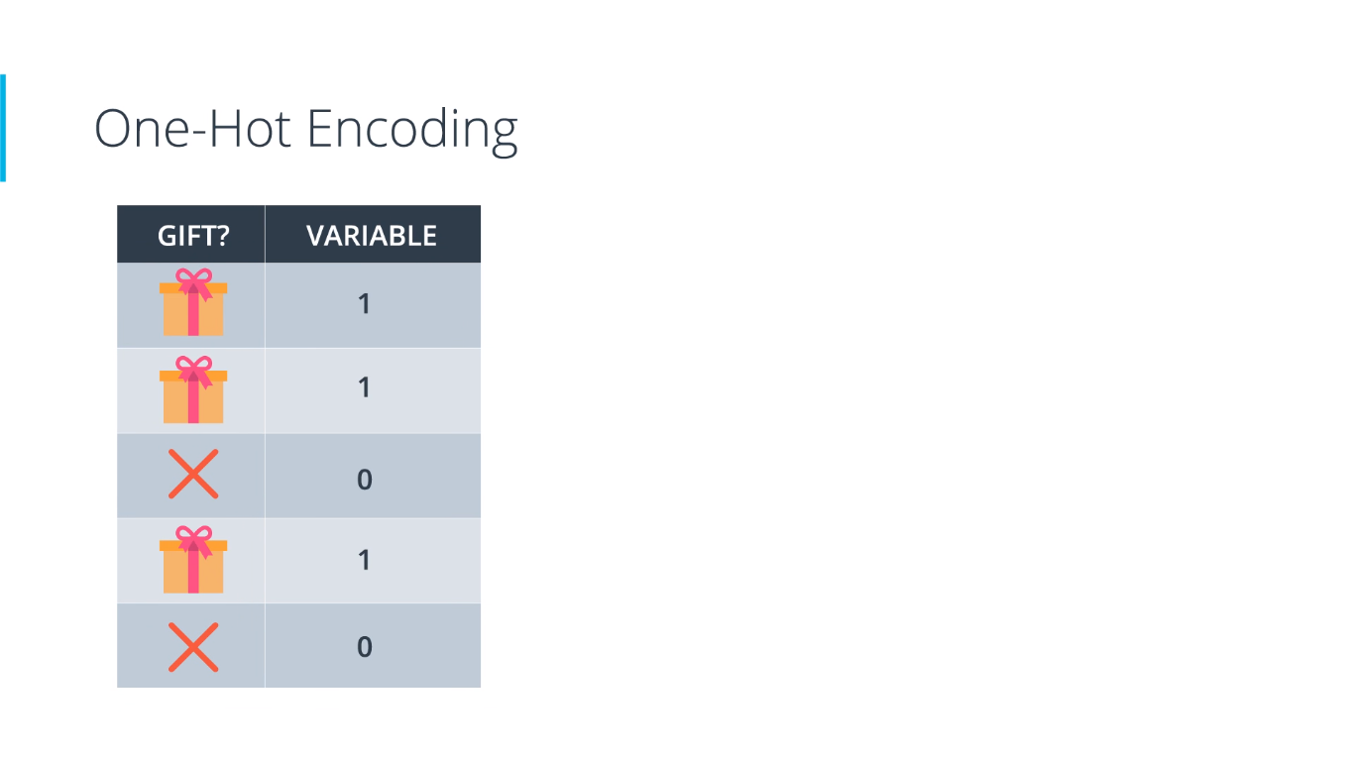
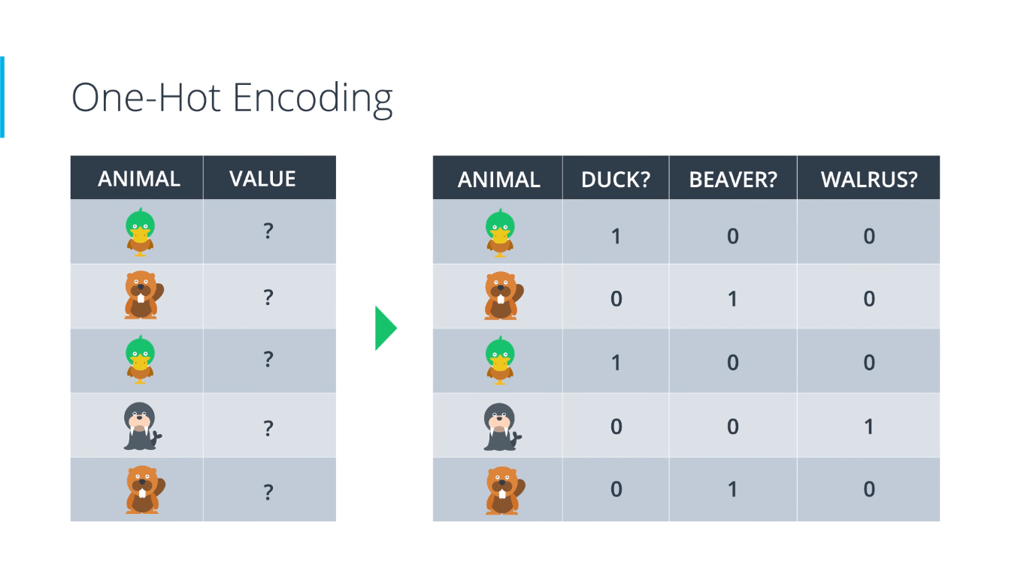

Slide 47
Maximum Likelihood
Maximizing Probabilities.

Slide 48
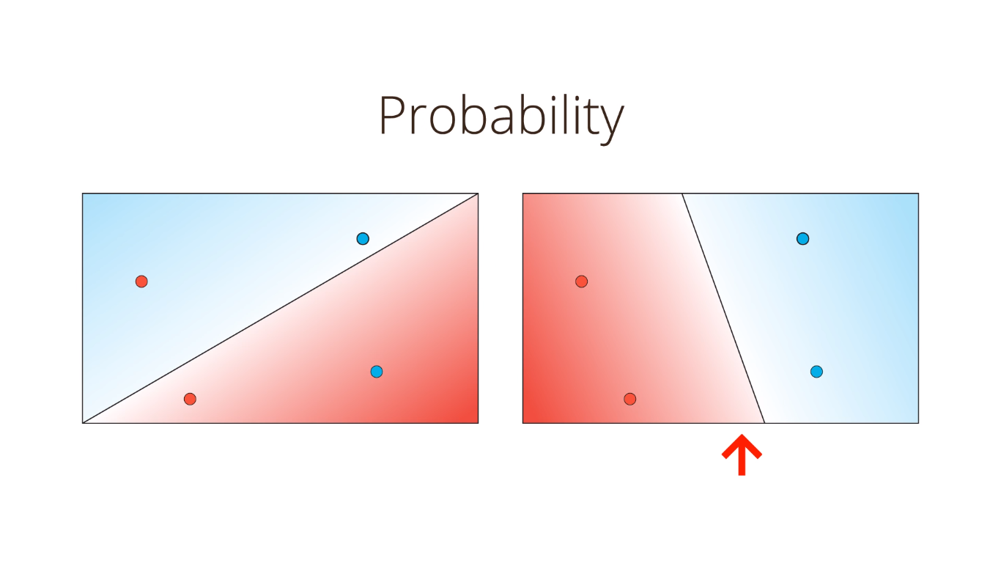

Slide 49
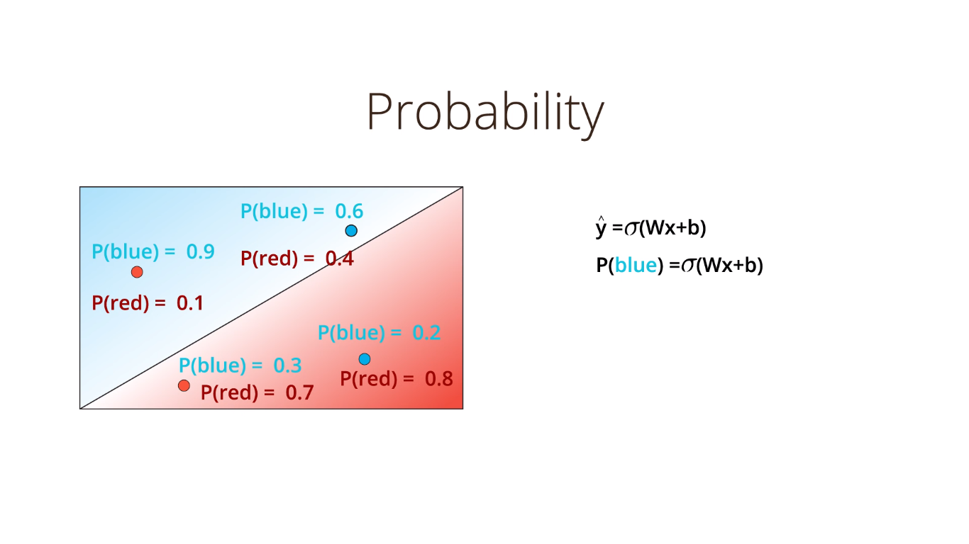

Slide 50
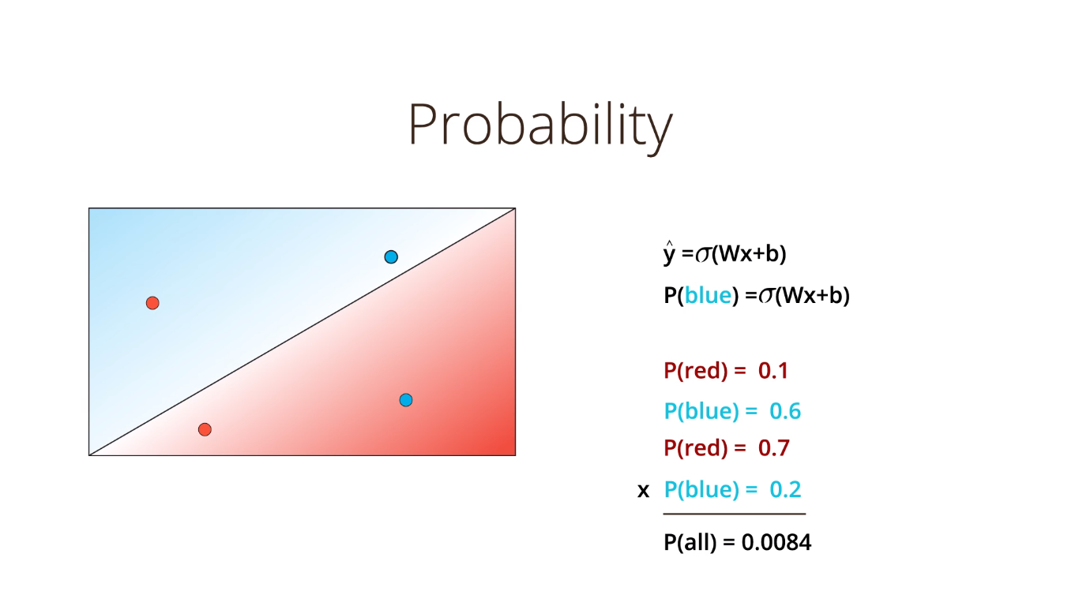
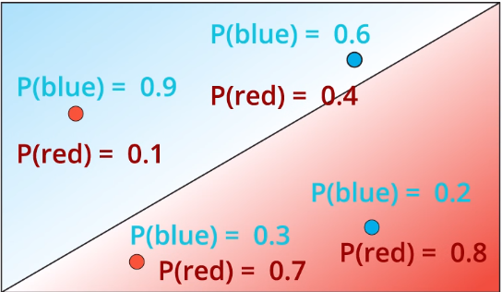

Slide 51
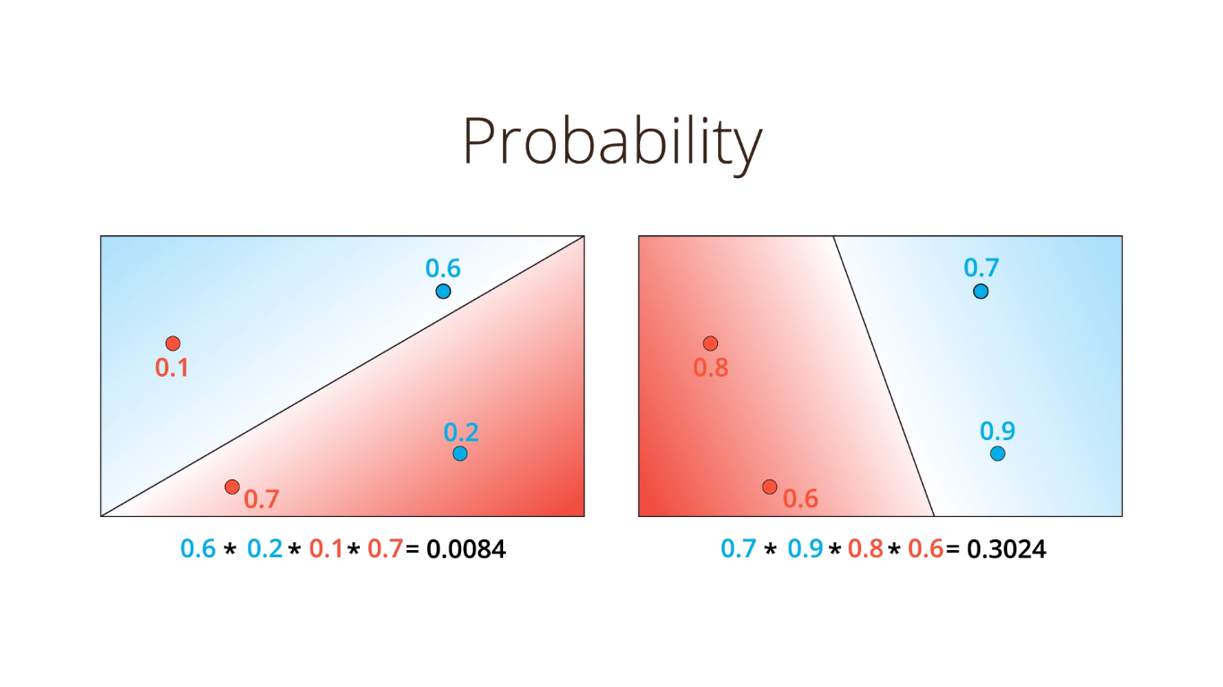

Slide 52
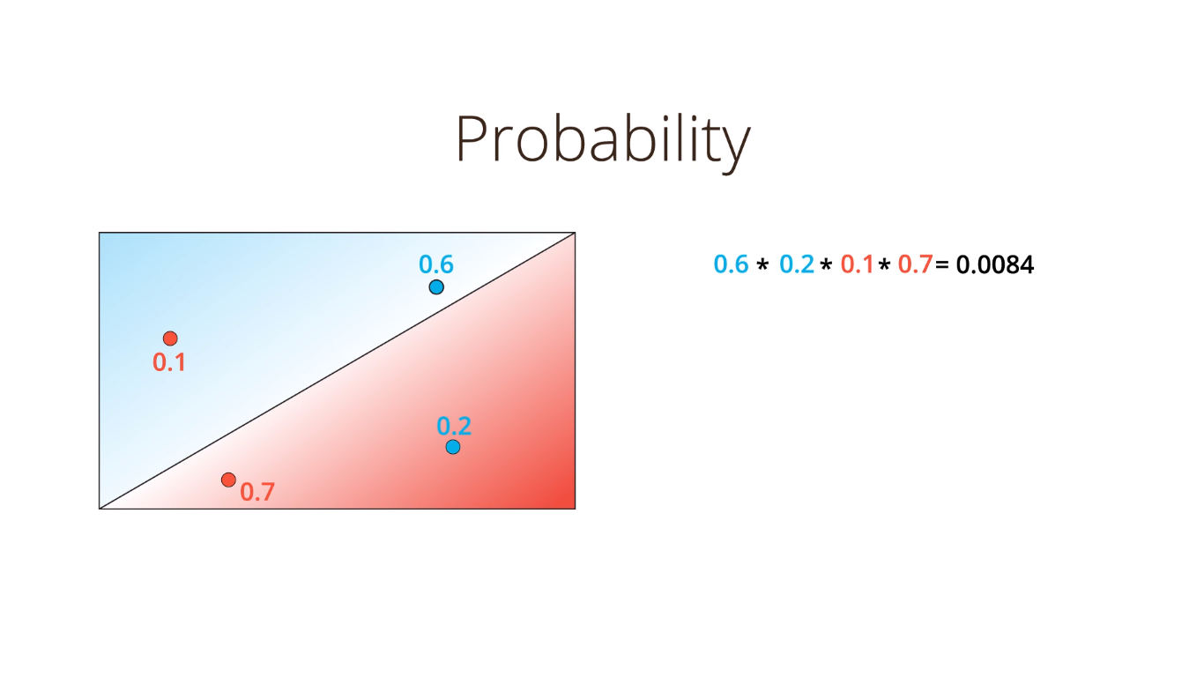
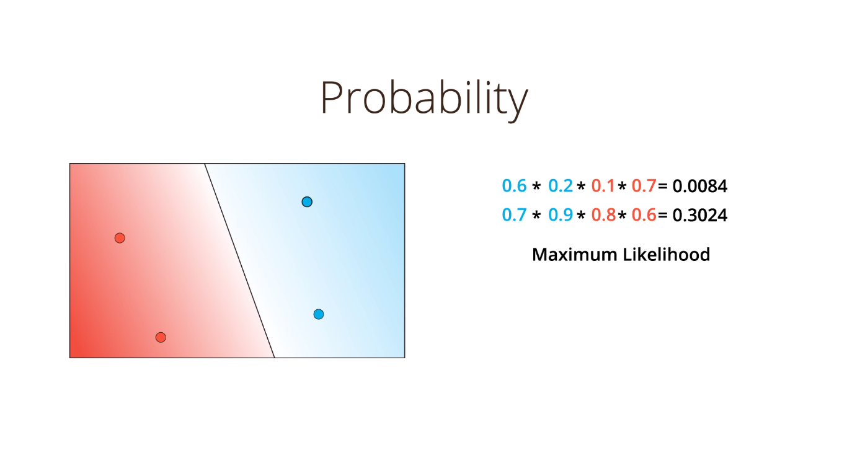
Maximize probabilities.
To be continued..

Slide 53
References.
Udacity’s Deep Learning Nanodegree Foundation.
A friendly introduction to neural networks.
Install Anaconda and set PATH.
Jupyter Notebook Tutorial: Introduction, Setup, and Walkthrough
Data Science with Python Pandas
An Introduction to Git and GitHub

